Slide 1
IoT Protocols

Slide 2
Overview
Examine some current apply IoT protocols
How to apply an IoT protocol in the application
Examine some IoT standards

Slide 3
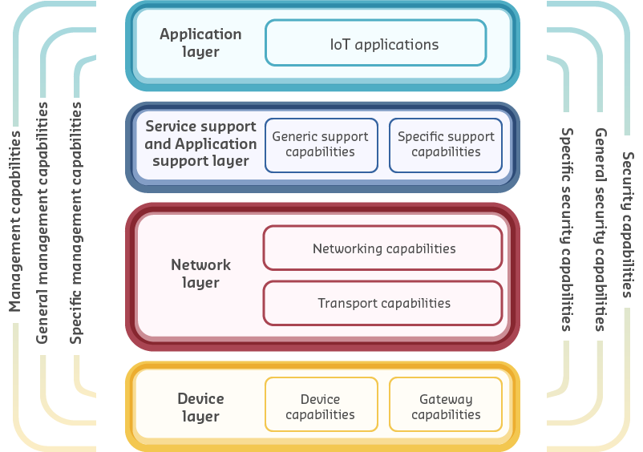
IoT Model & Protocols

Slide 4
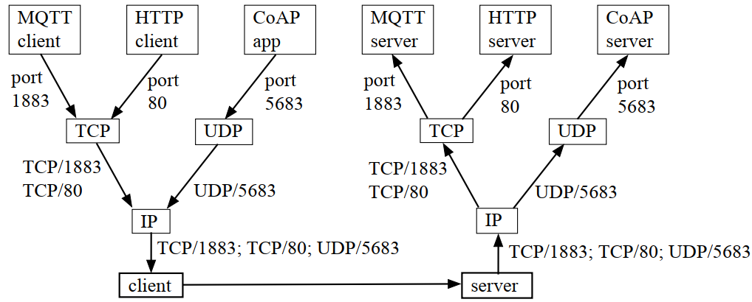
Application protocols

Slide 5
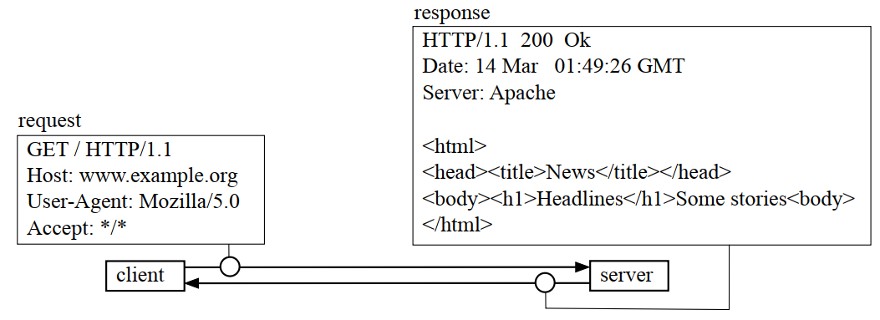
Request and response

Slide 6
Application protocols
The application protocols such as HTTP and XMPP, traditionally found in the Application layer. However, these are not suitable option for communication in an IoT constrained environment with a large number of connected devices. Therefore, more lightweight protocols are required by the IoT industry to address this problem.
Constrained Application Protocol (CoAP) and Message Queuing Telemetry Transport (MQTT) are the two most popular IoT application protocols [Hanes et al 2017].

Slide 7
Constrained Application Protocol (CoAP)
CoAP is based on HTTP protocol and was designed by the IETF Constrained RESTful Environment (CoRE) working group.
The communication between HTTP client and server is performed by using the Representational State Transfer (REST) standard. REST is a resource demanding standard, the lightweight RESTful interface was designed in CoAP so that resource-constrained devices in IoT networks can use RESTful services [Salman 2015]. Resources are retrieved from the server using URIs/URLs.
CoAP message exchange is done using UDP (User Datagram Protocol) with strong security measures, through the utilisation of the Datagram Transport Layer Security (DTLS) [Hanes et al 2017].
Both IPv4 and IPv6 are supported by CoAP, however IPv6 is used in IEEE 802.15.4 networks for constrained devices.

Slide 8
CoAP
CoAP performs the two main activities of messaging and request/response
There are four types of messages defined in CoAP:
confirmable (for reliable transmission)
non-confirmable (for unreliable transmission)
piggyback (acknowledgement)
separate (reset)
And four request/response methods:
GET (receive)
PUT (create)
PUSH (update)
DELETE
(similar to HTTP.)

Slide 9
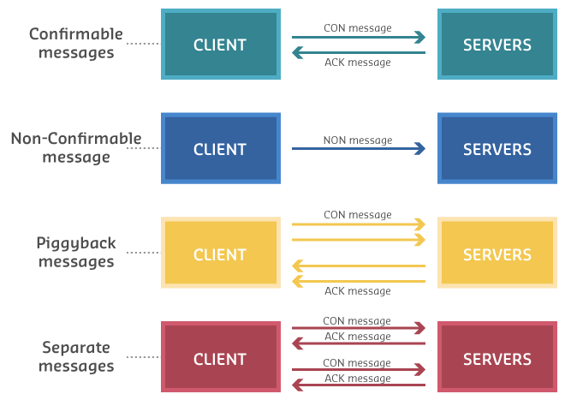
CoAP (cont.)

Slide 10
Message Queuing Telemetry Transport (MQTT)
In 1999, MQTT was introduced by IBM, and by 2013 it was standardised by OASIS [Salman 2015].
MQTT is a lightweight protocol specifically suitable for constrained environments - for example, a harsh environment with low bandwidth connection, such as in oil and gas industries.
MQTT protocol is the publish-subscribe communication framework between the nodes.
The three components of the MQTT network are:
publisher (client);
subscriber (client); and
message broker (server).

Slide 11
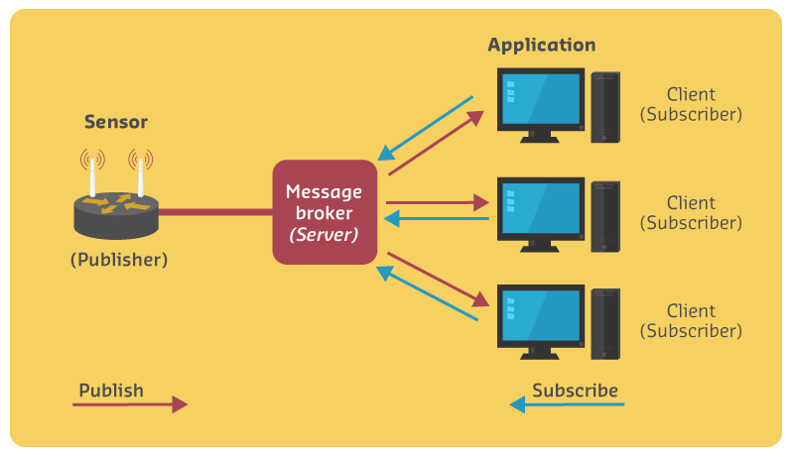
MQTT architecture
Notes:
In this example:
The MQTT publisher is a temperature and humidity sensor collecting environmental values and sending them to the MQTT server or message broker.
The message broker receives and accepts the connection and data.
Additionally, the message broker manages the subscription processes to transmit the publisher data to a subscriber interested in this data.

Slide 12
CoAP versus MQTT
FACTOR | CoAP | MQTT
Main transport protocol | UDP | TCP
Typical messaging | Request/response | Publish/subscribe
Effectiveness in LLNs | Excellent | Low/fair (Implementations pairing UDP with MQTT are better for LLNs.)
Security | DTLS | SSL/TLS
Communication model | One-to-one | Many-to-many
Strengths | Lightweight and fast, with low overhead, and suitable for constrained networks; uses a RESTful model that is easy to code to; easy to parse and process for constrained devices; support for multicasting; asynchronous and synchronous messages. | TCP and multiple QoS options provide robust communications; simple management and scalability using a broker architecture.
Weaknesses | Not as reliable as TCP-based MQTT, so the application must ensure reliability. | Higher overhead for constrained devices and networks; TCP connections can drain low-power devices; no multicasting support.

Slide 13
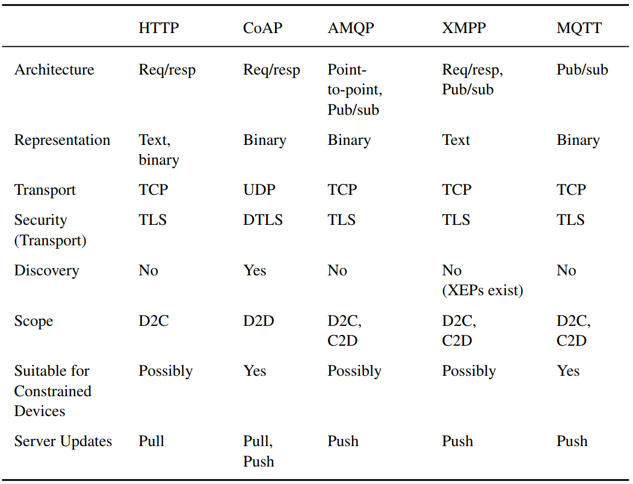
Other protocols and comparison

Slide 14
Transport protocols
Both Transmission Control Protocol (TCP) and User Datagram Protocol (UDP) are the core protocols for the TCP/IP protocol suite.
However, IoT applications mostly use UDP, TCP, and DTLS as transport layer protocols.

Slide 15
UDP, TCP & DTLS
UDP is a connectionless protocol with a very low overhead and fast transmission capabilities, but no guarantee for message delivery. It is usually compared to traditional mail delivery, as there is no acknowledgement for receiving a letter.
TCP is a connection-oriented protocol that guarantees the establishment of a connection between sender and receiver before data transmission. It is similar to a telephone system that requires a full connection between both ends before they can start talking to each other.
DTLS is a transport layer protocol based on Transport Layer Security (TLS). It provides security services for UDP communications.

Slide 16
Internet protocols
Internet Protocol version 6 (IPv6)
IPv6 is an upgrade to IP version 4 (IPv4), defined by IETF. It uses 128 bits addresses compared to the 32 bits addresses in IPv4, providing a larger number of addresses with integrated security features to accommodate the rapid growth of Internet users.

Slide 17
6LoWPAN
IPv6 addresses are too long for IoT data frames and methods; standards and protocols are required to encapsulate the IPv6 datagram in small packets. IPv6 over Low power Wireless Personal Network (6LoWPAN) is the first protocol to have successfully encapsulated the IPv6 for IEEE802.15.4 networks

Slide 18
RPL
One of the most popular routing protocols is IPv6 Routing Protocol for Low Power and Lossy Networks (RPL).
RPL is a distance vector routing protocol that determines the best route based on the distance between the nodes.
Routing is done by each and every node in a RPL network at the IP layer. That means all nodes in the network act as routers transmitting the IPv6 packets to the next hop, based on the destination information retrieved from the IPv6 packet header.
The RPL has two different modes: storing and non-storing.
RPL uses the Directed Acyclic Graph (DAG) concept to build the network.
In a Directed Acyclic (no cycles) Graph (pathway), the graph (pathway) cannot cycle round or return to the same node.
Routing loops and count-to-infinity problems (where messages go round and round loops and do not reach their destination) are addressed in RPL by using the RANK.

Slide 19
Network access and physical protocols
IEEE 802.3 Ethernet
IEEE 802.11 a/b/g/n/ac/ad/ah/ax WiFi
IEEE 802.15.4
LPWAN
Cellular

Slide 20
IEEE 802.3 Ethernet
IoT devices may be connected via a wired connection. For permanent connections, Ethernet is commonly used. The data rate using Ethernet can range from 10 Mbps to more than 1 Gbps (1000 Mbps). 10-base-T can be found on small microcontrollers; 100-base-T (100 Mbps) can be found on many higher-powered microcontrollers or single board computers.
Some examples of Ethernet-connected IoT devices are:
Cameras – video. Transmitting 4K quality video over WiFi may create problems due to the data speed constraints in WiFi
Voice (VoIP)
Set-top boxes - video/audio streaming and storage
Game applications and systems
Static industrial equipment
Sensors transmitting high security data, where transmitting via a wireless connection is viewed as high risk transmission
High-reliability control, such as robotics or medical applications

Slide 21
IEEE 802.11 a/b/g/n/ac/ad/ah/ax WiFi
IEEE 802.11, also known as WiFi, is a protocol replacing wired Ethernet for wireless communications. It uses the unlicensed radio band for data transmission (Parekh 2017). In a WiFi network, the transmitter or wireless access point (WAP) is responsible for translating the digital signals from wired network to radio signals, and vice versa, for communications between mobile devices in the WAP range and the Internet.
There have been a number of IEEE 802.11 protocol versions introduced since 1997, including: IEEE 802.11a , IEEE 802.11 b, IEEE 802.11 g, IEEE 802.11 n, IEEE 802.11 ac, IEEE 802.11 ad, IEEE 802.11 ah, and IEEE 802.11 ax. The last two protocols address the shortcomings in IoT-constrained environments.

Slide 22
IEEE 802.15.4
Since the traditional frame format of MAC layer protocols was not suitable for IoT low power and multi-hub communications, IEEE 802.15.4 was created with a more efficient frame format that has become the most used IoT MAC layer standard.
The common IEEE 802.15.4 IoT applications are:
Home and building automation
Automotive networks
Industrial wireless sensor networks
Interactive toys and remote controls
The commonly used IoT applications [list from Hanes et al 2017].
There are number of protocols based on IEEE 802.15.4, including ZigBee, 6LoWPAN, and Thread.

Slide 23
LPWAN
Low Power Wide Area Network (LPWAN) is a protocol for resource constrained devices and networks over long ranges. Some of the most well-known protocols based on LPWAN are LoRa, SigFox, and Weightless [McClellan 2017].

Slide 24
Cellular
Cellular networks are suitable for long distance communications in IoT applications.
Four generations of mobile communication have been developed over the past 30 years, and the fifth one is coming up by 2020:
2G: GSM & GPRS
3G
LTE (Long-Term Evolution) based on 4G
Notes:
The Global Service for Mobile communication (GSM) is a 2G (second generation) cellular network protocol that was developed by the European Telecommunication Standards Institute (ETSI) in 1991. GSM added fast data communication and introduced the Short Messaging System (SMS). In the later version the General Packet Radio Service (GPRS) was added to GSM, with the Multimedia Messaging System (MMS) as the main feature for sending video, pictures, and sound [Joan 2011].
To improve the speed and capacity of cellular networks, LTE (Long-Term Evolution) based on 4G was introduced by ETSI. LTE is replacing the GSM in IoT applications for M2M connection, with better connection and lower costs - however all cellular network protocols come with a high price that in most situations makes them too expensive to adopt.
The new LTE 4G includes the standardisation of NarrowBand IoT (or NB-IoT) that is a LPWAN technology.
Cellular networks are expensive technology, due to their utilisation of licensed Radio Frequency and intellectual property protection.
The 5th Generation cellular network is in progress, and will improve IoT communications. It also promises to lower costs, battery consumption, and latency. In a 5G network, data rates of hundreds of megabits are available per second for tens of thousands of users. It also enables several hundreds of thousands of simultaneous connections for massive wireless sensor networks.

Slide 25
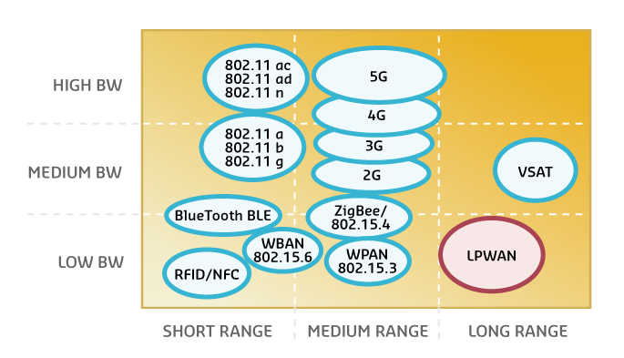
Bandwidth and coverage
Today’s IoT networks are best explained by looking at the bandwidth and coverage of each network technology,

Slide 26
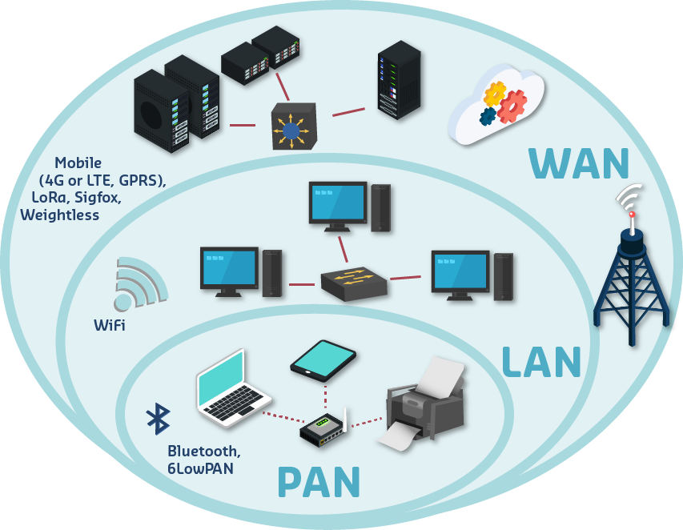
Network Technologies and Protocols

Slide 27
Bluetooth - BLE
Bluetooth Low Energy (BLE), a version of Bluetooth designed for low-powered devices, can help IoT devices conserve energy by maintaining the devices in sleep mode until they are connected. What makes BLE ideal for IoT applications is the fact that it can rapidly pair and reconnect with devices in six milliseconds (down from six seconds for classic Bluetooth).
The most common Bluetooth settings are:
Standard: Bluetooth 4.2 core specification
Frequency: 2.4GHz (ISM)
Range: 50-150m (Smart/BLE)
Data Rates: 1Mbps (Smart/BLE)

Slide 28
Zigbee
Zigbee is a WPAN protocol for low processing and low power devices. It has a low data rate that is less expensive than Bluetooth and WiFi, and based on IEEE 802.11.4.
Zigbee is suitable for infrequent data transmission at low-data rates within a small area, such as buildings.
Zigbee uses the ISM (Industrial, Scientific and Medical) frequency band, and has a data rate of approximately 250 kbps.
A microcontroller, Zigbee chips, and radio can add Zigbee compatibility to IoT devices.
Notes:
www.zigbee.org

Slide 29
LoWPAN
6LoWPAN can be seen as a combination of two protocols: Internet Protocol version 6 (IPv6) and Low-Power Wireless Personal Network (LoWPAN).
The required amount of resource consumption in Internet Protocol (IP) must be optimised to make it suitable for the IoT-constrained environment.
In 6LoWPAN, the Adaptation Layer is responsible for packaging and transporting the IP packets from the Internet layer to the Physical layer, so the end-to end connection is addressable, and a router can be used for routing tasks.

Slide 30
Thread
Thread is a new protocol based on multiple standards, including: IEEE802.15.4, IPv6, and 6LoWPAN. Like 6LoWPAN, it provides IP-based communications for resource-constrained devices, and can support 250 nodes in a mesh topology, with robust authentication and an encryption system.
Thread can be enabled on IEEE802.15.4 devices with a software upgrade.
Notes:
www.threadgroup.org

Slide 31
LAN
IEEE 802.11 ah, also known as WiFi HaLow, was published in 2017, and is specifically designed for IoT constraints by using the 900MHz license-exempt band. This allows for longer range and lower energy consumption, however due to hardware compatibility requirements for both the access point and connecting devices, chip vendors have shown little interest so far.
IEEE 802.11 ax uses both 2.4 GHz and 5 GHz ranges and OFDM modulation methods to create smaller but a greater number of channels for data transmission over the longer range. The IEEE802.11 ax will be released in early 2019.

Slide 32
WAN
Sigfox
LoRa

Slide 33
SigFox
SigFox is the pioneer of global IoT networks, with billions of sensors communicating with each other without the need to establish and maintain network connections.
Sigfox provides a software-based communications solution, where all the network and computing complexity is managed in the Cloud, rather than on the devices. This drastically reduces energy consumption and the costs of connected devices.
Standard: Sigfox
Frequency: 900MHz
Range: 30-50km (rural environments); 3-10km (urban environments)
Data Rates: 10-1000bps

Slide 34
LoRa
LoRa targets wide-area network (WAN) applications and is designed to provide low-power WANs with features specifically needed to support low-cost, mobile, secure, bi-directional communication in IoT, M2M and smart city and industrial applications. Optimised for low-power consumption and supporting large networks of devices, data rates range from 0.3 kbps to 50 kbps.
Europe 863 - 870 MHz
USA 902 - 928 MHz
Australia 915 - 928 MHz
China 779 - 787 MHz and 470 - 510 MHz (The Things Network 2018)

Slide 35
References
Cisco Australia and New Zealand. 2017. “Innovation Central Australia – Farm Decision Platform #InsideInnovation.” YouTube video 3:45; https://www.youtube.com/watch?v=AHNJEzOfKwQ
Hanes, D., Salgueiro, G. Grossetete, P. Barton, R. and Henry J. 2017. "IoT Fundamentals: Networking Technologies, Protocols, and Use Cases for the Internet of Things," ed: Cisco Press, Indiana.
Joan, Ben. 2011 "Difference Between GSM and GPRS." DifferenceBetween.net. July 27, 2011 http://www.differencebetween.net/technology/difference-between-gsm-and-gprs/
McClellan, Calum. 2017. “IoT Connectivity – Comparison of LoRa, SigFox, RPMA, and other LPWAN Technologies.” Article in iot for all; https://www.iotforall.com/iot-connectivity-comparison-lora-sigfox-rpma-lpwan-technologies/
Parekh, Jatin. 2017. “WiFi’s evolving role in IoT.” article in Networkworld.com; https://www.networkworld.com/article/3196191/lan-wan/wifi-s-evolving-role-in-iot.html
RF Wireless World. 2012. “RPL vs CORPL vs CARP – difference between RPL, CORPL, CARP IoT” article available from; http://www.rfwireless-world.com/Terminology/RPL-vs-CORPL-vs-CARP.html

